Slide 1
AViDD Helicase Inhibitors Chemistry projects with Piramal
SGC-UNC
July 2022

Slide 2
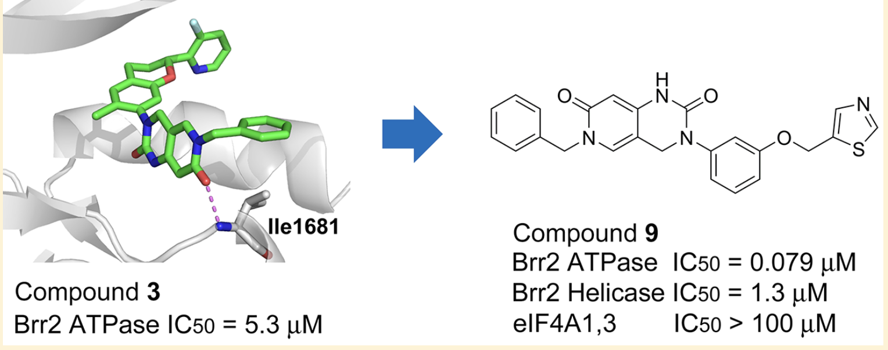
Project#1: Brr2 Analogs
Goal is to make diverse library for testing on multiple helicases
Propose making 5 X 20 library using 5 diverse alkylating agents and 20 anilines

Slide 3
Project#1: Brr2 Analogs
Key intermediate
Make it >10 g
Second Key intermediate
With R₁ = Ph
Make it >1 g
R1
R2

Slide 4
Project#2: Thiazoles sulfonamide
Initial strategies
Proof of concept series:
10 different acid (left part)
5 different sulfonamide (right part)
-----
10 different left part with urea linker
5 sulfonamide
-----
Total 100 analogs

Slide 5
Project#2: Thiazoles sulfonamide (Amide series)
Amines
20 X 5 = 100
Acids

Slide 6
Project#2: Thiazoles sulfonamide (Urea series)
20 X 5 = 100

Slide 7
Project#3: NSP13 inhibitors (library from docking)
Project#4: Ribose and 2’-Me intermediate for Kathie @ UMBC
Project#5: Key intermediate for Fesik @Vanderbilt

Slide 8
Project#1: Primial compound nomenclature format (Example)

